Slide 1
AIMS OF THE DAY!
1
Notes:
Hello, my name is Miles Mount and I used to be the Marketing Director of a medical equipment company based in Holland. I have also set up companies in the UK and USA.
Today we will try and explain the difference between Marketing and Sales and give you a few tips on selling your product, at Trade Fairs and other venues.

Slide 2
2
Notes:
Marketing vs Sales

Slide 3
What's the difference?
3
Notes:
What’s the difference?

Slide 4
What's the difference?
Marketing
Getting people to want to visit your stall:
4
Notes:
Marketing is doing your Market Research, choosing the correct product, deciding on the correct price, and last but not least getting people to visit your stall at School or at a Trade Fair and visit your website on-line.

Slide 5
What's the difference?
Marketing
Getting people to want to visit your stall:
Sales
Persuading people to buy whilst you have their attention:
5
Notes:
Sales is usually used to describe the techniques to persuade the potential customer to buy the product while you have their attention.

Slide 6
MARKETING
6
Notes:
OK, let’s break MARKETING into several areas.

Slide 7
Prepare your Business Plan
Marketing is the route plan
to get you to your destination
in the most effective way
7
Notes:
You cannot travel effectively without deciding where you want to go!
This is Marketing, a route plan to get to your destination in the most effective way.
What do you want to achieve?
What do you need to concentrate on?
How will you achieve your goals?
Monitor your progress and alter course if necessary.
Let’s look at these in more detail.

Slide 8
Type of business
Profit/Non-profit
Target customer
Product
8
Notes:
Set your Business objectives.
Do you want to make a profit – it’s best to plan to make a profit or you will go out of business fairly quickly in the real world.
Who are the target customers and what are you going to sell?
Do your market research.
The initial market research can be simply asking yourselves “Do I want to buy this product and what would I pay?”

Slide 9
Who is in charge?
What is the budget?
Who do I have to help?
Type of business
Profit/Non-profit
Target customer
Product
9
Notes:
The Marketing Director will work very closely with the Managing Director, but you should also brainstorm with all your colleagues to get the best ideas.
A close eye must be kept on the budget.
It’s no good spending a fortune on advertising if the product is low value or low quantity sales.

Slide 10
Who is in charge?
What is the budget?
Who do I have to help?
Type of business
Profit/Non-profit
Target customer
Product
How will Marketing contribute?
What does Marketing want to achieve?
Create Brand
10
Notes:
In these days of Covid-19 we will be working much more on-line and Marketing should co-ordinate with Social Media to get the most effective market penetration.
A recognisable Brand is a great help in keeping your Company and Product in front of people.
Think of the recognisable logos and slogans you know.
Nike – Just Do It.
Apple – Think Different.
Wendy's – Where's the Beef?
L'Oreal – Because You're Worth It.
M&Ms – Melts in Your Mouth, Not in Your Hands.
De Beers – A Diamond is Forever.

Slide 11
Who is in charge?
What is the budget?
Who do I have to help?
Type of business
Profit/Non-profit
Target customer
Product
How will Marketing contribute?
What does Marketing want to achieve?
Create Brand
How do we achieve goals?
When do we know we have achieved them?
How do we keep to the strategy?
11
Notes:
Marketing strategy.
You must decide where you want to go before you set off.
Monitor your progress and if you hit a traffic jam, or any other problems, then you may consider changing your route, or even your final destination.
It is permissible to change your product to suit changes in the market, or if your original market research was wrong.

Slide 12
Who is in charge?
What is the budget?
Who do I have to help?
Type of business
Profit/Non-profit
Target customer
Product
How will Marketing contribute?
What does Marketing want to achieve?
Create Brand
How do we achieve goal?
When do we know we have achieved them?
How do we keep to the strategy?
Sales are an unknown factor
What if strategy is wrong?
Is the overall strategy clear?
12
Notes:
The Marketing and Sales teams must work closely together.
If a product is not selling and you cannot devise a strategy to make it sell, then consider additional, or changed, products.

Slide 13
Who is in charge?
What is the budget?
Who do I have to help?
Type of business
Profit/Non-profit
Target customer
Product
How will Marketing contribute?
What does Marketing want to achieve?
Create Brand
How do we achieve goal?
When do we know we have achieved them?
How do we keep to the strategy?
Sales are an unknown factor
What if strategy is wrong?
Is the overall strategy clear?
Who does what when?
Does everybody know what to do?
Is the overall strategy clear?
13
Notes:
Keep reviewing the progress and make changes as necessary.
Experiment with different advertising and sales techniques to find what works best.
Explain unconditional money back guarantee in USA

Slide 14
SALES
14
Notes:
Sales.
Your main sales opportunities are at School and at a variety of Trade Fairs, particularly the LEAP ones at the Merrion Centre.
Saturday December 3rd 2022
Saturday February 4th 2023

Slide 15
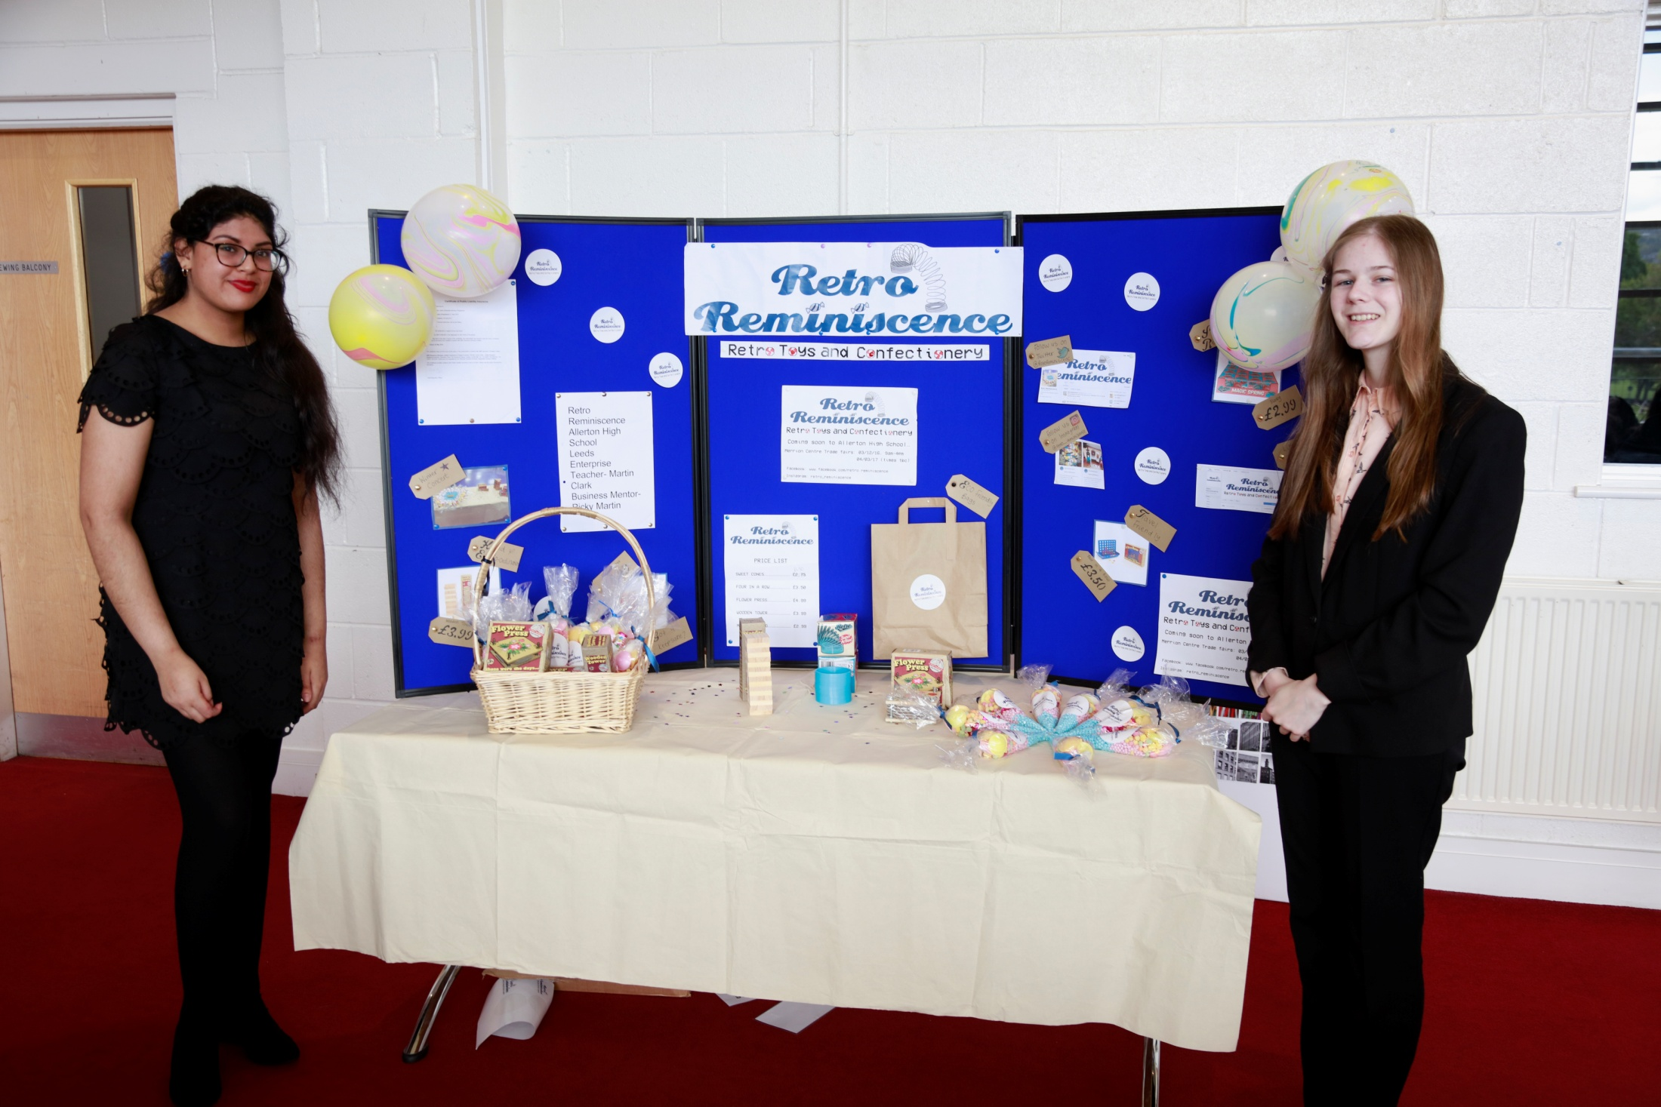
Notes:
In this covid-19 year there may have to be more virtual sales opportunities. Sell online as well as Trade Fairs.

Slide 16
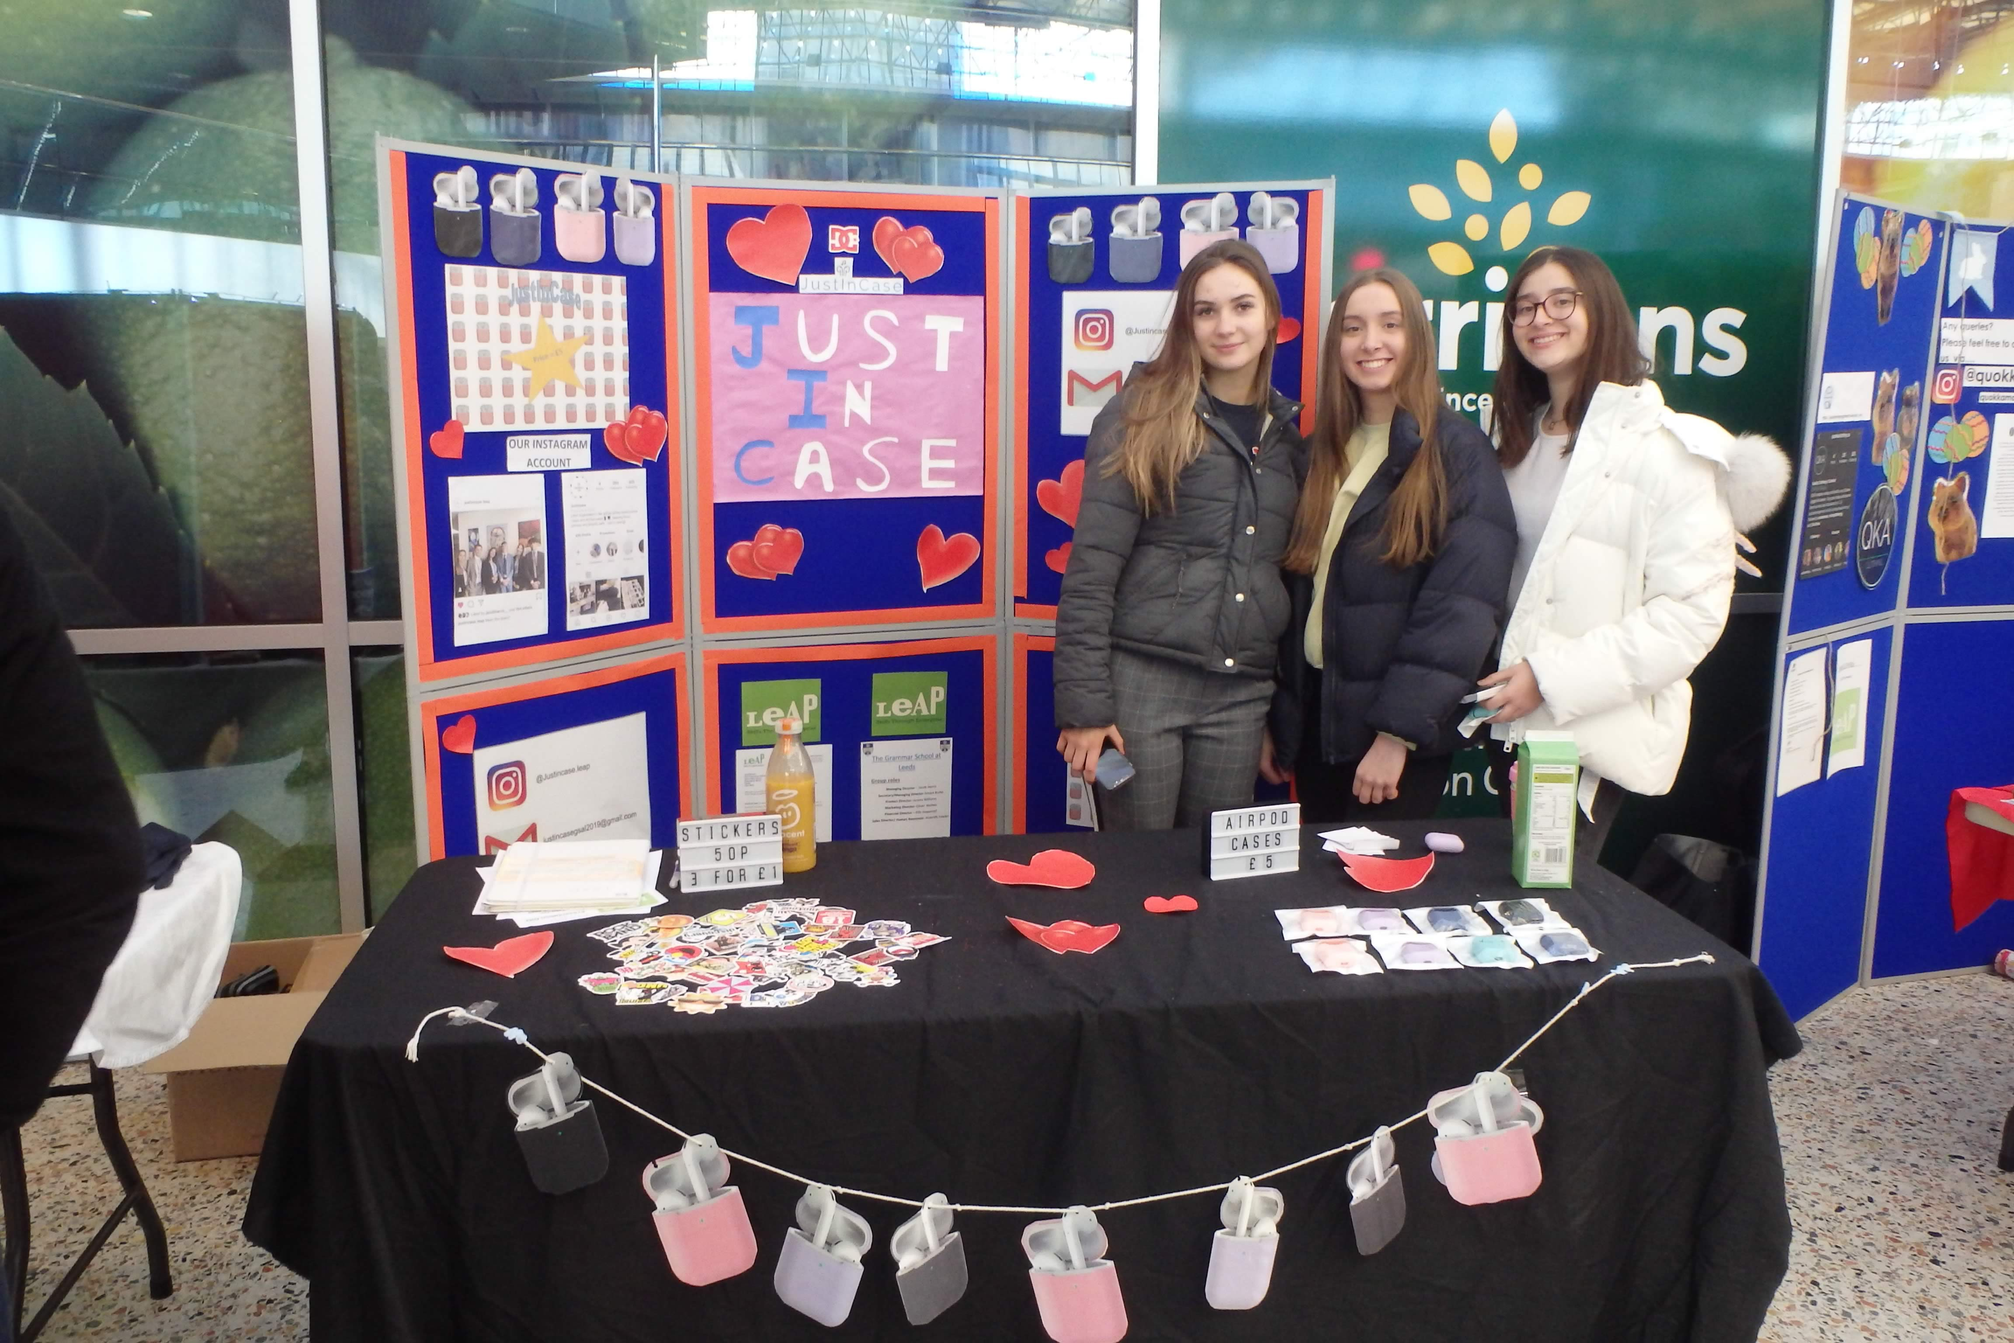
Notes:
There are examples of previous years Trade Stands on the LEAP website.
Read the guidelines on what we expect to be on your Trade Stand.

Slide 17
Documentation
Name of college/school
Company name
Business Mentors and their companies
Product samples
Background information
Contact details
Media coverage
Third party endorsements
Price
Promotions and offers
Folder with business plan, minutes and financial information
17
Notes:
It always surprises us at LEAP the number of Companies that don’t read the guidelines and therefore are marked down by the judges.
Make sure the judges have access to your folder with business plan, minutes of meetings and financial information.
Also make the judges aware of any press or media coverage you may have had.

Slide 18
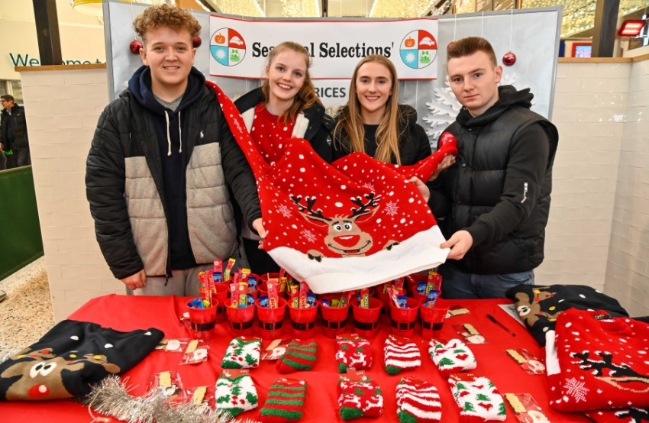
Stand Appeal
Am I drawn to your stand?
How do you present yourselves?
Is your name clear?
Is it obvious what you do?
Are the staff well presented?
Is it an interesting stand?
Do I want to find out more?
Is the price clearly stated?
Have you used
Signage
Lighting
Images
18
Notes:
Make sure your stand is visually attractive, and that all the sales people are well presented and not looking bored or otherwise occupied.
Is it obvious what you are selling?
Is the price of the goods clearly shown?
Remember that enthusiasm is infectious and a smile costs nothing.

Slide 19
Wrong Attitude
Focussing on the customer?
19
Notes:
Of course you would never look at your phone rather than speak to a customer.
You may be hungry and thirsty, but the stand is not the place to have your refreshments.

Slide 20
Wrong Attitude
Focussing on the customer?
20
Notes:
Many companies use a themed t-shirt as a uniform, or if you are selling clothes, maybe the stand staff should wear examples.
If we have live Trade Fairs in winter be aware that it may be cold and therefore wear appropriate clothing. Someone who is frozen blue does not really look their best!

Slide 21
Wrong Attitude
Focussing on the customer?
Was it a long evening?
21
Notes:
I don’t care how tired you are from the night before, or all the studying you have been doing, you must appear eager and awake for the customers.

Slide 22
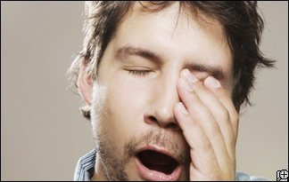
Wrong Attitude
Focussing on the customer?
Was it a long evening?
Looking bored?
22
Notes:
It is a good idea to have a stand rota so no-one is on duty for too long. If you look bored you will not get many sales!

Slide 23
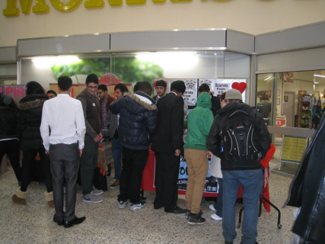
Wrong Attitude
Focussing on the customer?
Was it a long evening?
Looking bored?
Nice to see friends – but! ….
23
Notes:
We all know that your Company and its members are the most popular in the school and that all your friends want to come to your stand. That is great if they are buying, but it is also easy to put customers off and scare them away.

Slide 24
Wrong Attitude
Focussing on the customer?
Was it a long evening?
Looking bored?
Putting the customer off?
Nice to see friends – but! ….
24
Notes:
Of course, there are many ways that we can put customers off buying! - but the object of the exercise is to attract potential customers and convert their interest into sales and profit.

Slide 25
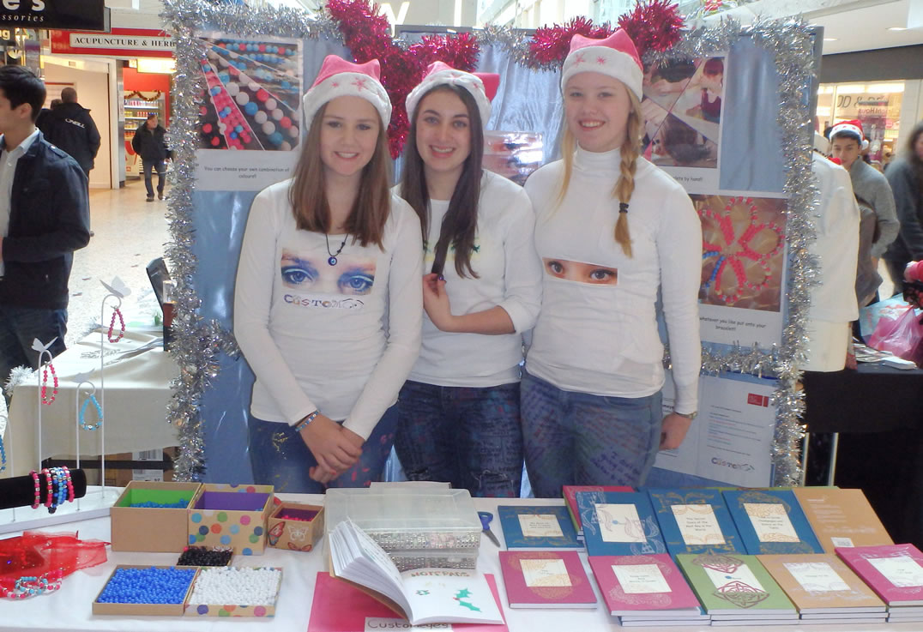
Right Attitude
Smartly Dressed
25
Notes:
So! That is enough about what not to do, now lets be positive and see what the Right attitude is.
Be smartly dressed.

Slide 26
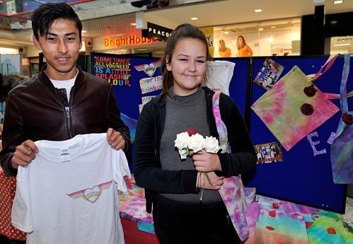
Right Attitude
Smartly Dressed
Enthusiastic and welcoming
26
Notes:
Be enthusiastic and welcoming.
A smile costs nothing and is your best sales tool.

Slide 27
Right Attitude
Smartly Dressed
Enthusiastic and welcoming
Ask Questions
27
Notes:
Try to ask open questions that do not get a one word or negative response.
I’m afraid that my usual reply to a salesperson in a shop who says “Can I help you”
is “No thanks, I’m just browsing”
Engage the customer in conversation
Is this for you or your daughter?
Do you prefer the red or the green?

Slide 28
Right Attitude
Smartly Dressed
Enthusiastic and welcoming
Ask Questions
Smile
28
Notes:
Did I mention it is a good idea to smile?
If one of your colleagues manages to sell more than anyone else then learn from that person.

Slide 29
Right Attitude
Smartly Dressed
Enthusiastic and welcoming
Ask Questions
Smile
29
Notes:
You must encourage the customer to Trust you. Always be honest and never lie to a customer.
Never knock the competition – the customer may have just visited them and liked them.
Knocking the competition is one thing that would make me sack a salesman immediately. The customer wants to know what your company can do, not what another company cannot do.

Slide 30
Knowledge
Know
EVERYTHING about the product or service
EVERYTHING about the business
THREE POINTS that your team must communicate to the customer and judges
Predict
what the judges may ask
Pricing, margin, sales so far, product details
Rehearse
opportunity to communicate achievements
Have an administration folder with you
30
Notes:
When the judges are visiting your Trade stand they will also ask questions. The worst answers you can give are “I don’t know you will have to ask the Finance Director”
- or the clever so and so who says “I’m afraid that is confidential information!” or even “This is the wrong venue for us we don’t expect to sell much”.
Try instead: “I don’t know but I can find out very quickly and come back to you”
Key questions that you should always know are:-
Your Sales to date,
your buying-in prices
and your margin.

Slide 31
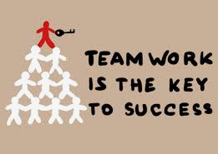
Teamwork
Have a staff rota so your sales team stays fresh and enthusiastic
Know the role of each member
Know the objectives of the company
How did your team go about reaching those objectives?
Business IS successful teamwork
Communication
Negotiation
Trust
Shared responsibility
31
Notes:
I’ve mentioned earlier, and I don’t mind repeating that you should have your staff on a rota so that no-one gets too tired or bored.
Everyone is involved in sales not just the Sales Director.
In the Business world the reputation of the company and sales depends on every company member from the person who answers the telephone, customer service, engineers, delivery drivers and of course Sales people.

Slide 32
Negotiating the sale
How do you go about selling?
Market research
Products or service
Meeting the needs of a customer
Packaging and presentation
Promotion
Price
Perceived value for money
Enthusiastic sales team
32
Notes:
Of course you have done your Market Research [as a start ask yourself “Would I buy this?”]
You have chosen the best product to sell.
Unless you are really lucky the customer doesn’t always know they need the product until you work your magic with the packaging and presentation, advertising and persuasive talking [don’t push too hard, you will scare the customer off].
The price is set based on the buying in price, the margin, VAT and last but not least “Would you pay that amount?”. Consider special offers such as buy 2 get a third one at half price.
Everybody likes to feel they have got Value for Money
– A Good Deal!

Slide 33
Guidelines
Give yourself a chance before you start
The guidelines are there to help you
Read them, check them
33
Notes:
Some companies forget to read the guidelines for Trade Fairs, Report Competitions, Presentation Competitions etc.
If you do not read the rules how can you expect to follow them?
The guidelines are all in the resource “How it all works” on the LEAP website.

Slide 34
RESULTS
34
Notes:
I hope this brief seminar has given you some ideas.
I have always said that Marketing is a chance to experiment and solve a problem and Sales are a result of sharing your enthusiasm for a product and satisfying a customer’s needs – even if they didn’t know they had the need until they visited your stand!

Slide 35
Notes:
Any Questions?

Slide 36
Notes:
Any Questions?

Slide 37
Any Questions?
For further information
www.leapenterprise.co.uk
Or email
donna@leapenterprise.co.uk
Or
milesmount@yahoo.com
Notes:
Any Questions?

