Slide 1


Marketing Presentation
8TH OCTOBER 2024
THOMAS HAIGH
Notes:
Introduce yourself as a Marketing Coordinator at Town Centre Securities. Mention how you've managed campaigns that significantly increased engagement and sales.

Slide 2
Aims for Today
“Marketing is no longer about the stuff you make but about the stories you tell.” - Seth Godin
01
02
03
Introduction to Marketing and Sales
How to attract and engage customers
Tips for executing effective campaigns
Notes:
I Share how you developed digital strategies that worked in real-world settings, giving practical examples of your successes.

Slide 3
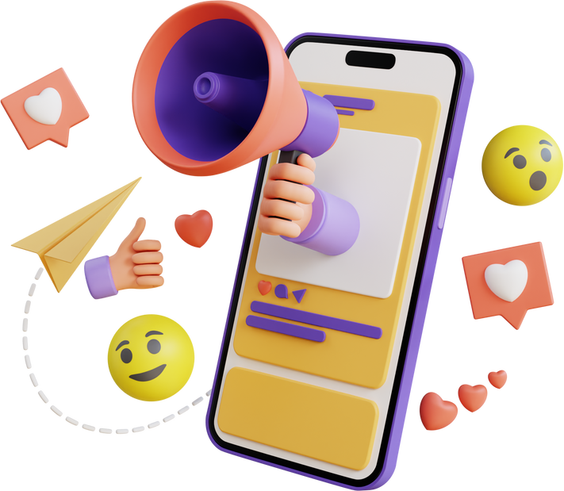

Marketing vs Sales
Marketing:
Attract customers to your stall/product
Sales:
Convert interest into a purchase
Notes:
Marketing: Attracts and engages potential customers through various channels like social media, email, advertising, and content. It builds awareness, trust, and interest in a product or service. The goal of marketing is to generate leads and nurture them, creating long-term brand recognition and loyalty.
Sales: Focuses on converting interested leads into customers by directly persuading them to make a purchase. It typically involves one-on-one interaction, addressing objections, and closing the deal. Sales is the final step of turning engagement and interest into a transaction.
Use an example from your experience: how marketing campaigns like your Merrion Centre footfall campaign built awareness and interest, while your sales team capitalized on that engagement to drive conversions.
Emphasize that both Marketing and Sales are critical parts of a business strategy, but they serve different functions in the customer journey.

Slide 4
The Role of Marketing
1
  2
  3
Create Brand Awareness
Set your goals and objectives
Build a strong customer relationship
Notes:
Share your experience in branding and digital strategies for Brontë Birthplace.
Discuss how you set clear objectives for each campaign, monitored progress, and adjusted strategies as needed.
Emphasize the importance of a clear plan.

Slide 5
Marketing Mix
"Business has only two functions – marketing and innovation." – Milan Kundera
PRODUCT | PRICE | PLACE | PROMOTION
Product 01 | £5 | Stall | Point of Sale
Product 02 | £10 | Online | Social Media
Product 03 | £7 | Stall | Social Media
Notes:
Anyone know what the additional Ps of Marketing are?
Processes, People and Physical Evidence

Slide 6
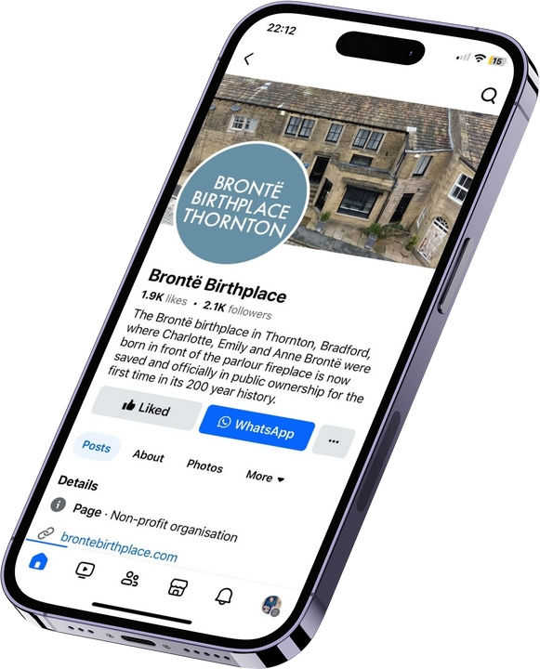
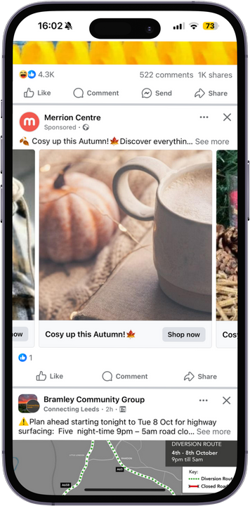
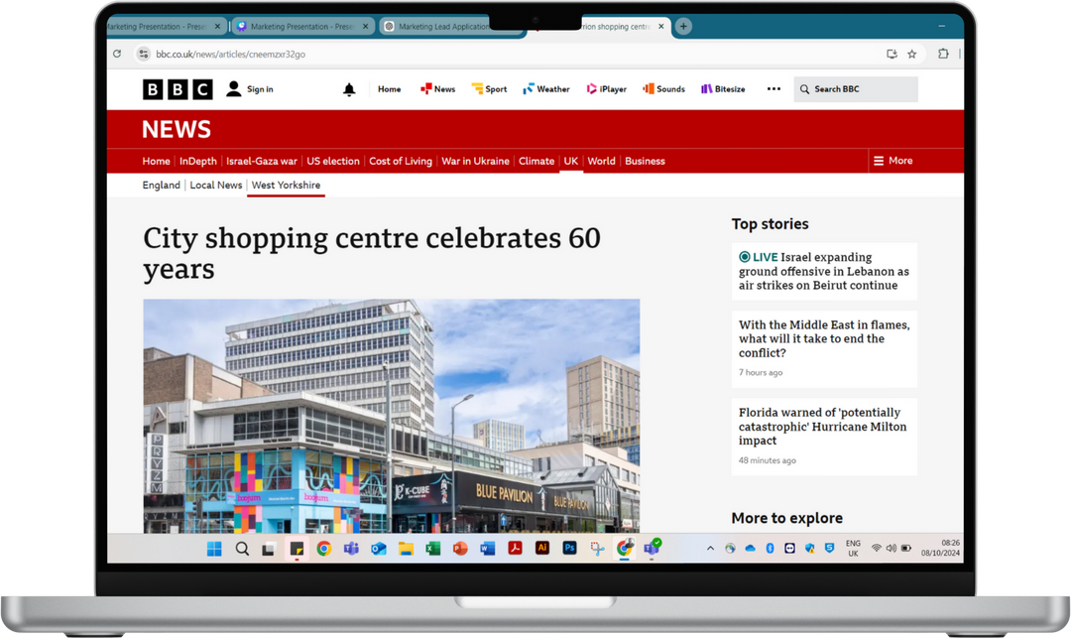
Using Social Media and Digital Channels
Social media: Engage, inform, and convert
Email marketing & PPC (Pay-Per-Click)
SEO, blogs and
external PR
Notes:
Explain your use of social media and digital marketing at Brontë Birthplace and Town Centre Securities.
Mention tools like Adobe Creative Suite and Canva for quick content creation.
Share how these digital marketing efforts helped boost online engagement and visibility.

Slide 7
Planning Events & Promotions
Define Objectives
Target Audience
Budget & Resources
What do you want to achieve? Is it awareness, sales, or engagement?
Who is your event for? Tailor your promotions to their interests.
Determine the budget and allocate resources wisely.
Promote Effectively
Event Execution
Write your agenda point
Use digital channels (social media, email, ads) to build excitement leading up to the event.
Ensure everything runs smoothly on the day, including logistics, attendee experience, and on-brand communication.
Follow up with attendees, share event highlights on social media, and measure your event’s success.
Notes:
Collaborating with Teams & Partners:
Work closely with internal teams (sales, product, customer service) to ensure that all aspects of the event align with the broader marketing goals.
Collaborate with external partners for joint promotions, such as co-hosting events or charity initiatives.
Certainly! Here’s an expanded version of Slide 5: Planning Events & Promotions to include more detailed content:
Slide 5: Planning Events & Promotions
Slide Text:
Steps to Successful Event Planning:
Define Objectives: What do you want to achieve? Is it awareness, sales, or engagement?
Target Audience: Who is your event for? Tailor your promotions to their interests.
Budget & Resources: Determine the budget and allocate resources wisely.
Promote Effectively: Use digital channels (social media, email, ads) to build excitement leading up to the event.
Event Execution: Ensure everything runs smoothly on the day, including logistics, attendee experience, and on-brand communication.
Post-Event Engagement: Follow up with attendees, share event highlights on social media, and measure your event’s success.
Collaborating with Teams & Partners:
Work closely with internal teams (sales, product, customer service) to ensure that all aspects of the event align with the broader marketing goals.
Collaborate with external partners for joint promotions, such as co-hosting events or charity initiatives.
Visual:
A flowchart or timeline that shows the key steps: from setting objectives, targeting audiences, planning resources, promoting, executing, and following up.
Talking Points:
Share your experience planning successful joint charitable events at the Merrion Centre with Yorkshire Children's Charity and Child Friendly Leeds. Discuss how collaboration with these partners led to broader community engagement and amplified the event’s impact.
Highlight the importance of cross-functional collaboration in your current role, ensuring that all departments work together seamlessly to create a cohesive event experience. For example, your role in coordinating marketing efforts while working with customer service and product teams.
Emphasize how post-event engagement is critical. Mention how you followed up after your events to maintain relationships with attendees and keep the momentum going on social media.

Slide 8
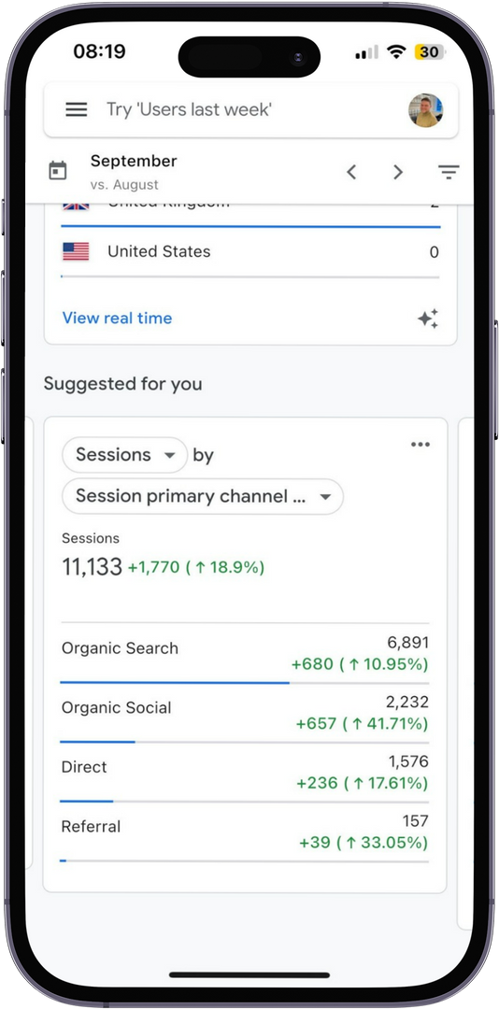
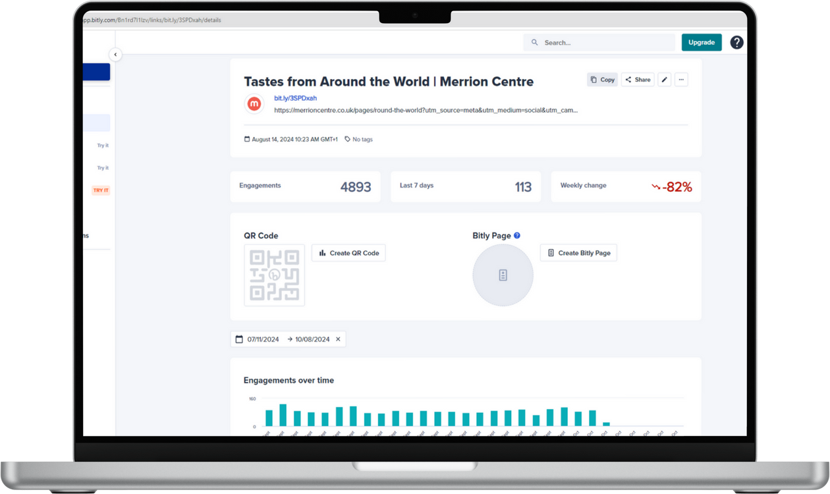
Monitoring Success
  Track performance using analytics
  Adjust strategies based on data
  Record and report your findings accordingly

Slide 9
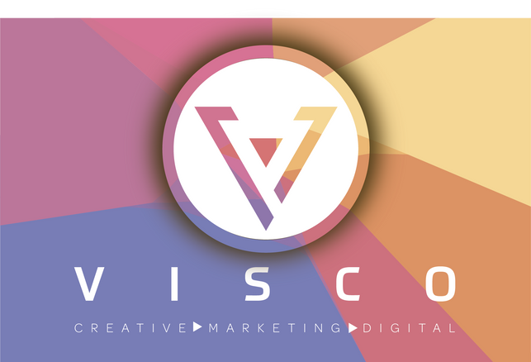


My Marketing Journey
Freelancing: VISCO Agency
During my freelancing period, I built and managed over 10 websites for SMEs, developing their brand identity and enhancing their digital presence with effective SEO strategies and engaging designs.
Employment: Merrion Centre
As a Marketing Coordinator at Town Centre Securities, I successfully led several high-impact campaigns, including boosting footfall at the Merrion Centre by 15% through targeted digital marketing efforts.
Volunteering: Brontë Birthplace
In my volunteer role at Brontë Birthplace, I designed and manage their website, using digital marketing strategies to raise awareness and engage the community, while leading all marketing and communications activities.

Slide 10

Thank You.
Notes:
Marketing attracts, sales convert
Plan, monitor, and adjust
Collaborate and build strong teams

